Slide 1

ML4HST Conclusion

Slide 2

Summary of Material
The basics of machine learning
Model construction, training/testing, and deployment
Common loss functions
Common optimizers
More complex machine learning concepts
Convolution networks
Recurrent networks
Generative networks
Machine Learning in autonomous systems
The basics of Quantum Mechanics and Quantum Computing

Slide 3
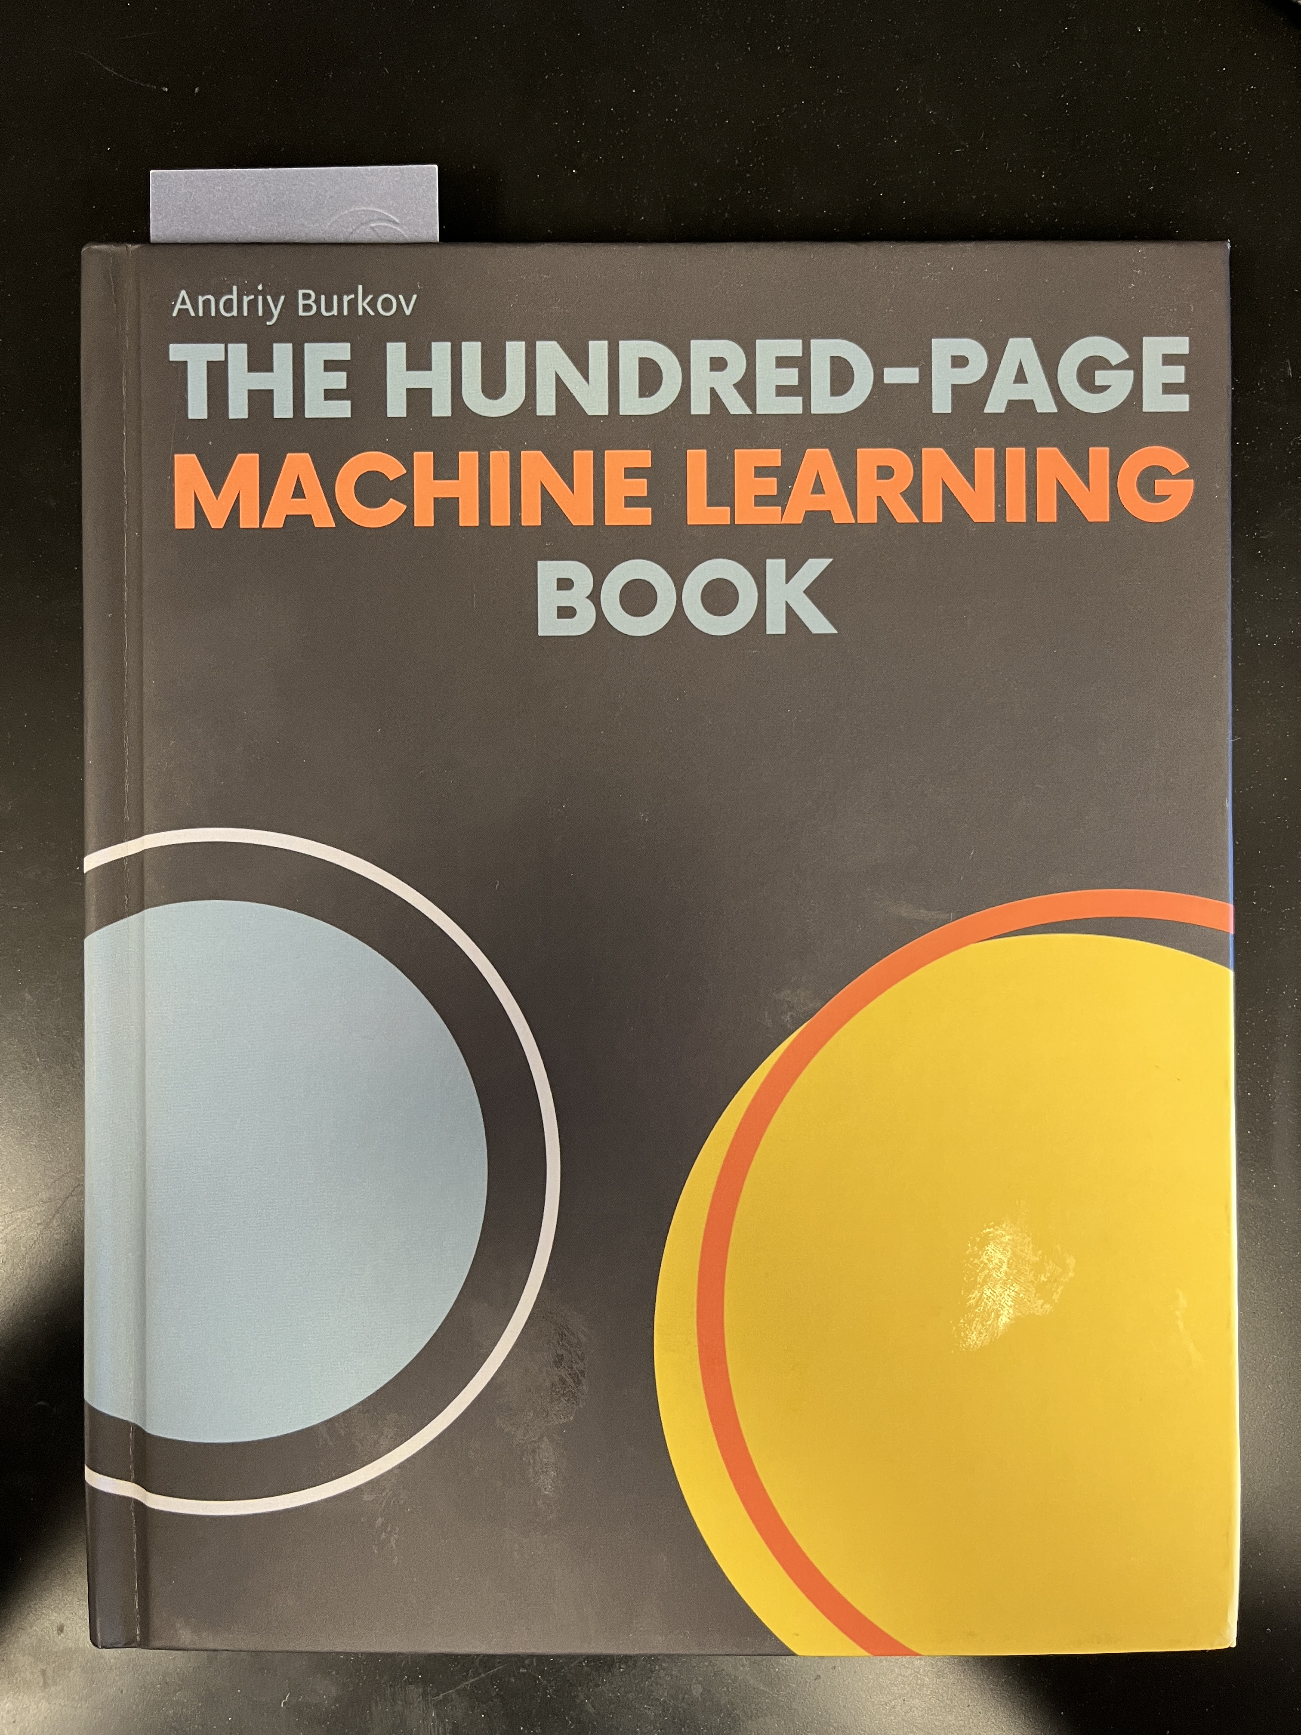
Continuing Your ML Education
There are many online (1 , 2 , 3) and print (1 , 2 , 3) sources to continue learning about ML
There are also sites focused on helping teachers bring ML into the classroom (1 , 2 , 3)
ML is constantly changing so make sure that the information you read is as up to date as possible
Everyone gets a copy of "The Hundred-Page Machine Learning Book" by Andriy Burkov to help keep you going with ML

Slide 4
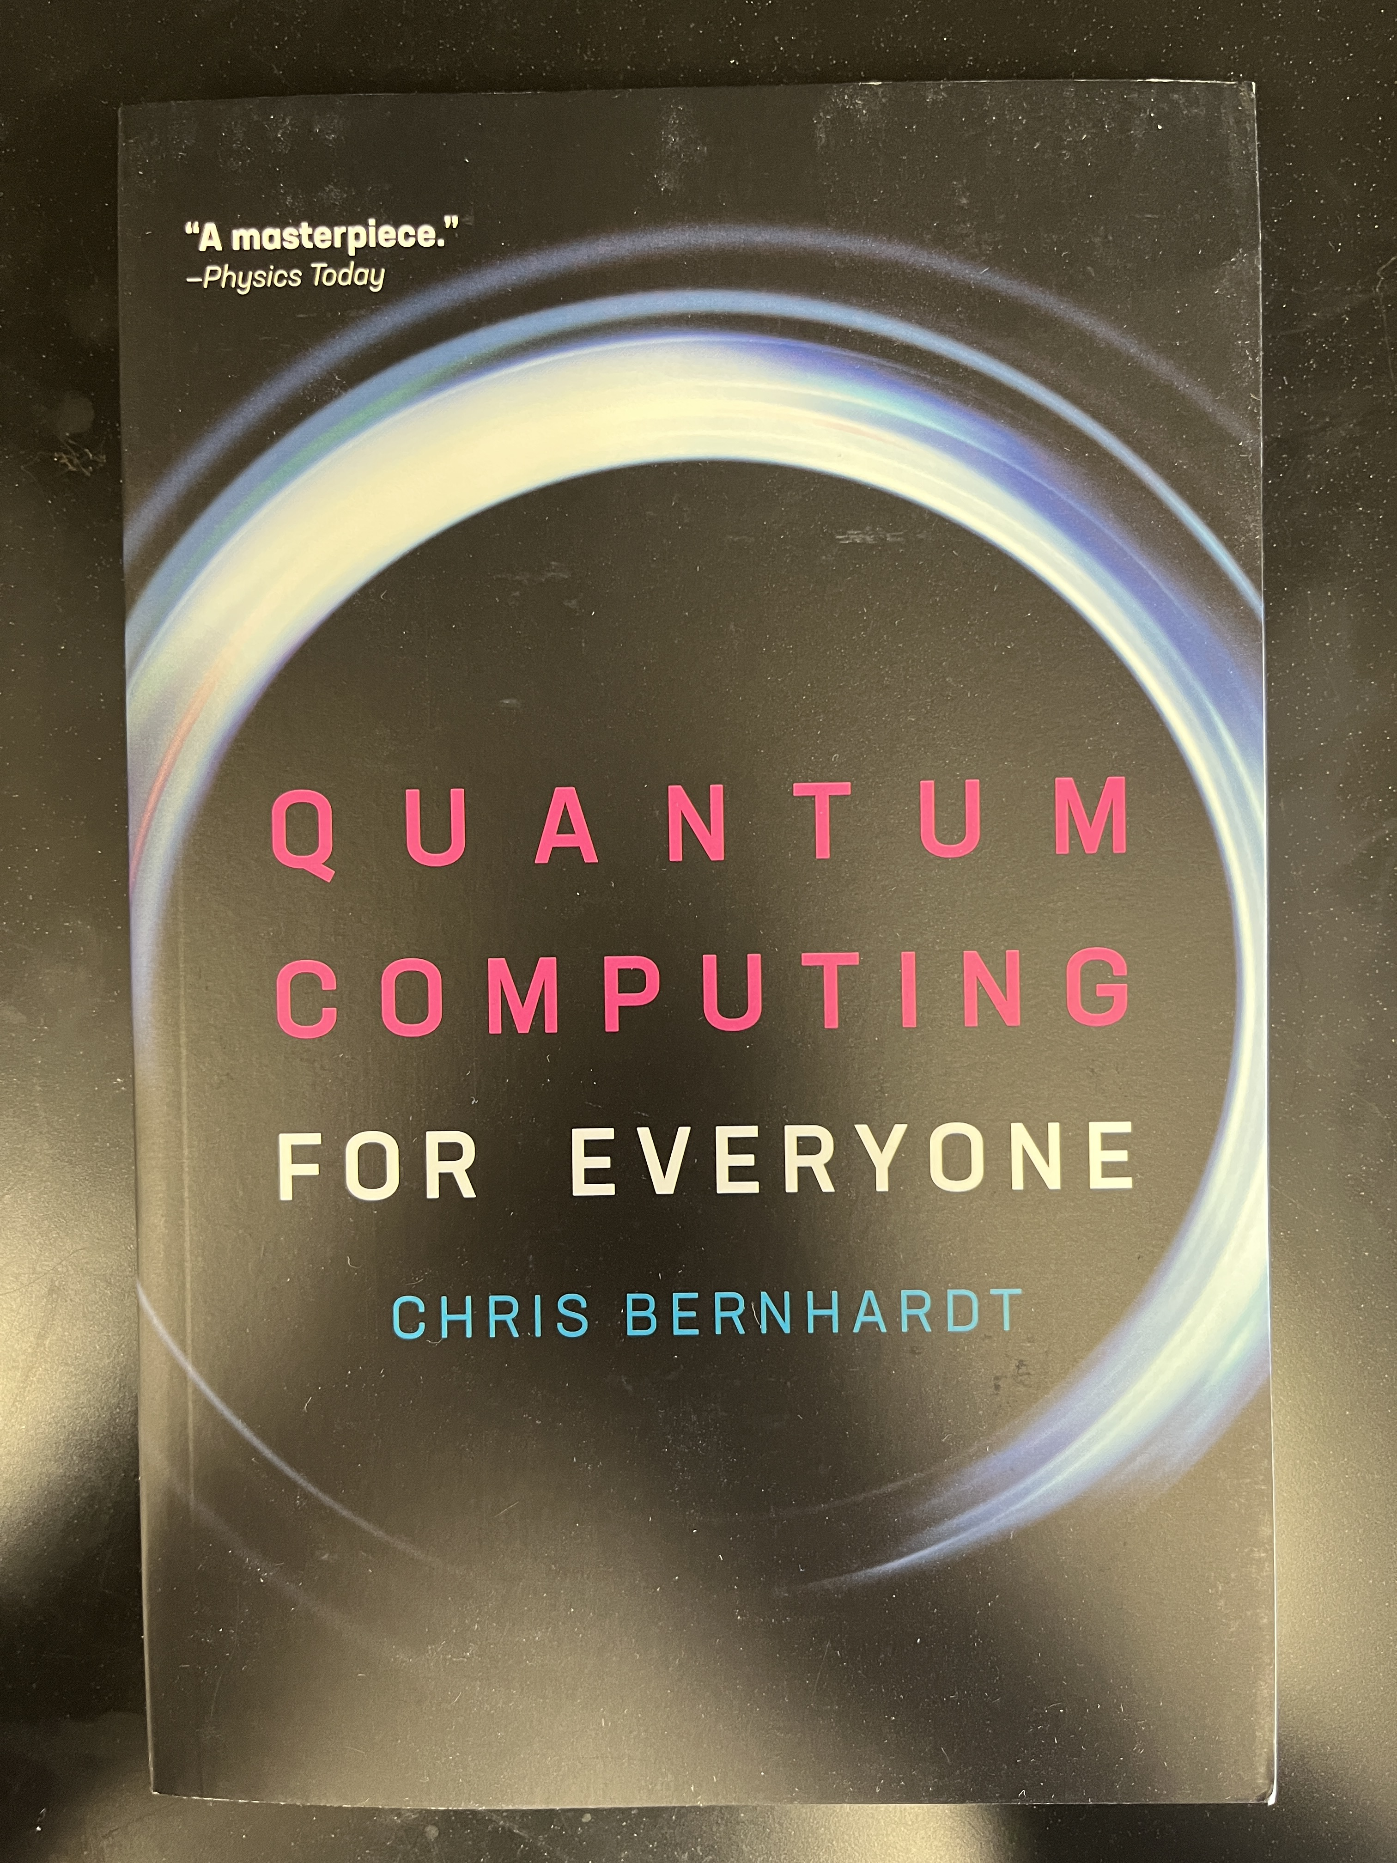
Continuing Your Quantum Education
Quantum Computing is still in its infancy so there are fewer online sources (1 , 2 , 3) and books (1 , 2 , 3) to learn the basics
Everyone gets a copy of "Quantum Computing For Everyone" by Chris Bernhardt to help keep you going with Quantum Computing

Slide 5



Thank You For Attending

